Slide 1
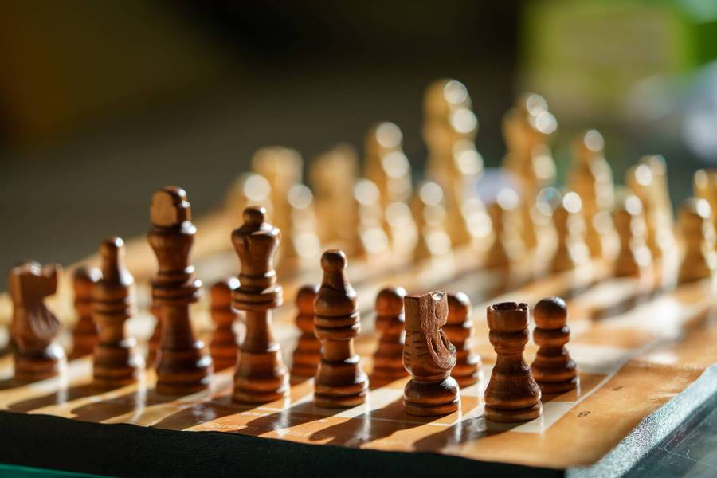
Chess Artificial Intelligence
Team Members:
ROHITH ABBURI
NUTHAN KISHORE MADDINENI

Slide 2


Project TOPIC
Implementation of Chess.

Slide 3

Statement of Project Objectives
Create a Chess AI that makes intelligent and optimal moves by implementing the Reinforcement Learning for enhanced decision-making efficiency.

Slide 4
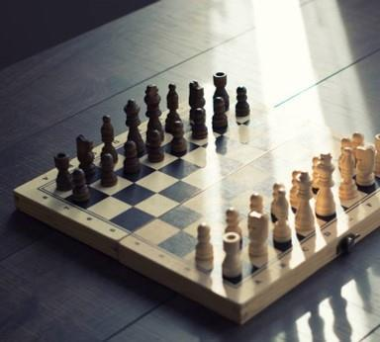
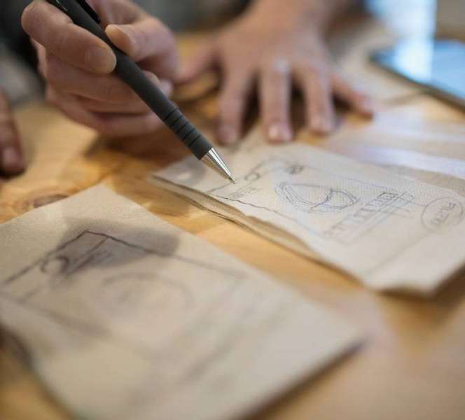
APPROACH
Choose a programming language conducive to AI development, such as Python, and employ it to construct a Chess Game.
Establish the Chess rules and board structure within the program. Implement a Reinforcement Learning using Q-Learning to enable the AI to traverse the game in a resource-efficient manner.

Slide 5

Deliverables
Functional Chess Game capable of playing against human players or other agents.
Source code repository(GIT) containing the AI implementation, with detailed documentation.
Detailed documentation of AI algorithms and strategies used in the project

Slide 6
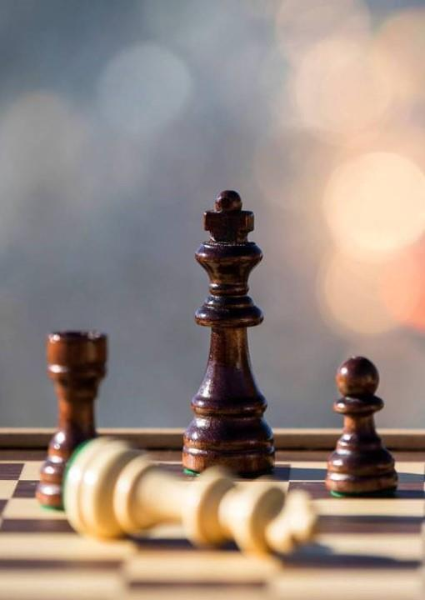
Evaluation Methodology
1
The AI agent's ability to make intelligent moves and win games against opponents.
Performance metrics of AI using different techniques.
The clarity and completeness of the documentation provided.
Test the robustness of the AI in handling various game scenarios.
2
3
4

